Slide 1
Multiple linear Regression
By Adrian Vasquez
ISDS 474 Sat 9am
11/26/2021

Slide 2
Before Running the Regression, I Checked The Five Assumptions: First was Linearity
Linearity= Use a scatter plot with dependent variable on the y axis and the independent variables on the x axis. Then check if there is a linear relation. For most variables there were no linear relation but there were a few that did like the ones below. If I were Strick with the linear assumption, then I would have no variable to include in the model, so I choose to put all variable in model

Slide 3
Assumptions: Normality, Homoscedasticity, and Independence
I used a scatterplot of the residuals to check Normality, Homoscedasticity, and Independence, and since all variable selected in feature selection are normally distributed and are randomly scattered with a rectangle pattern, I concluded they meet the three assumptions mentioned above.

Slide 4
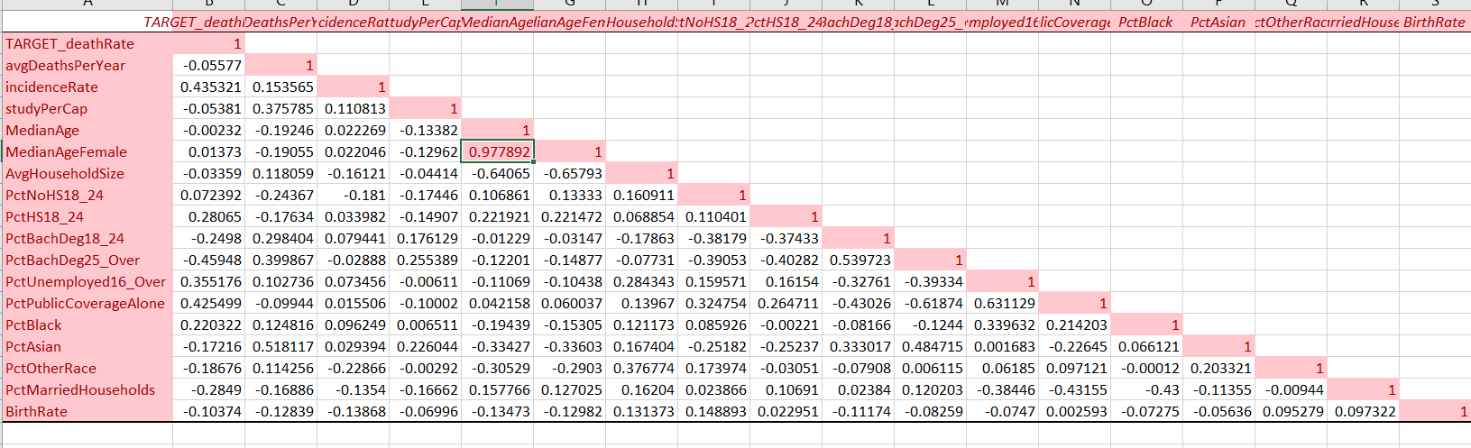
Assumption of Multicollenarity
To check multicollinearity, I used correlation matrix and the only variables that were Corelated was median age and female median age. Because they had a correlation of .97, I decided to take out Female Median Age. The reason I did not use Female Median Age was because it had a bigger P value than median age. Also, when running the dimension reduction, the included subsets did not include female median age as selected subset variable.

Slide 5
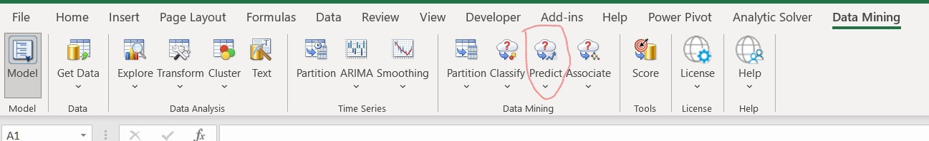
Linear regression
After data is clean and partitioned, go to data mining tab and select prediction icon then select linear regression.

Slide 6
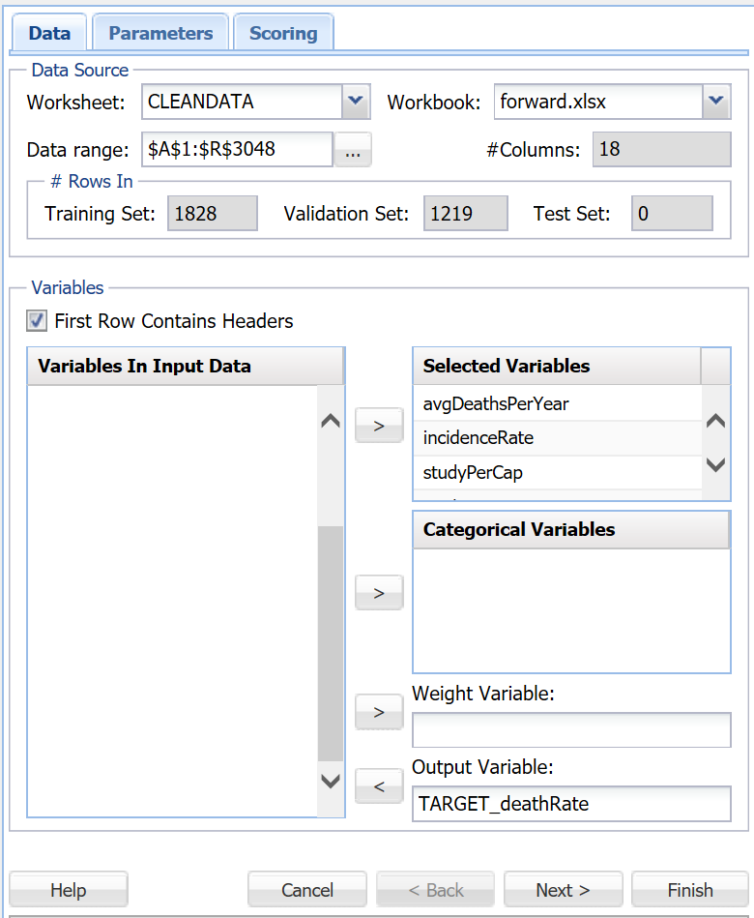
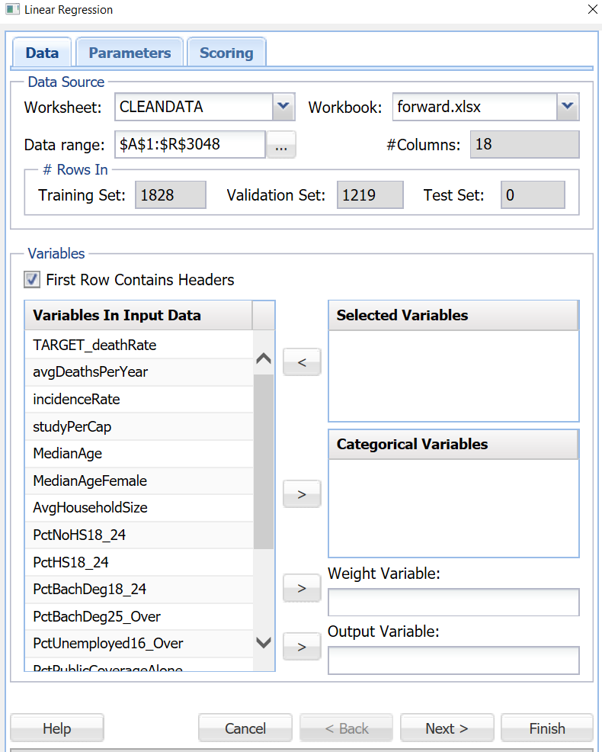
Variable Selection
First you must select what variables will be the dependent/output variable and independent aka the selected variables that you want to include in the model.

Slide 7
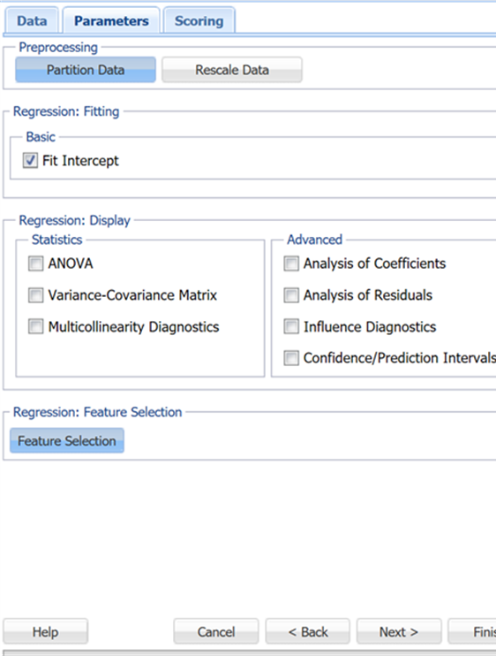
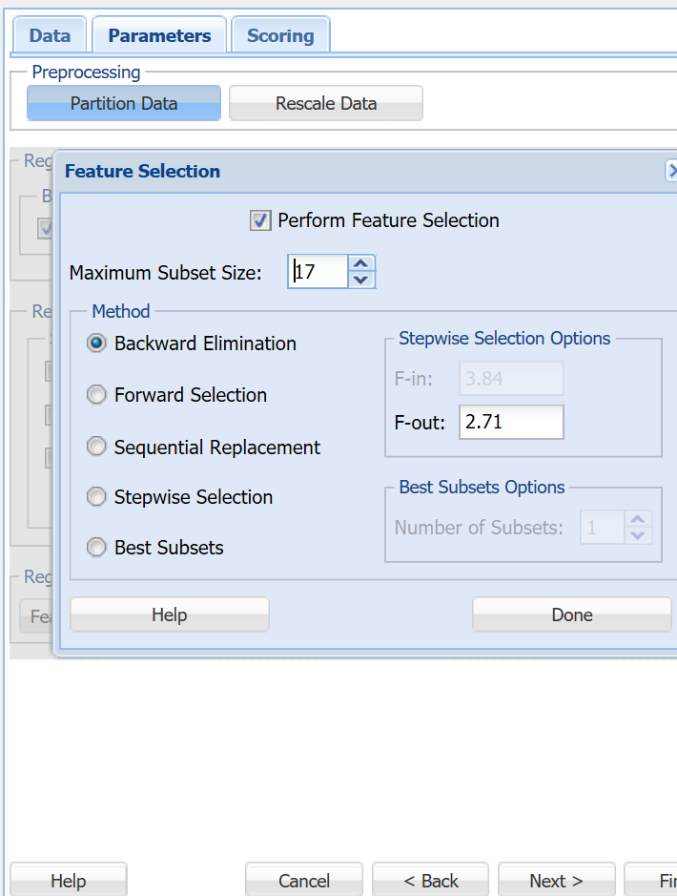
Feature selection
The next window is the parameters window sown on the left will appear. The parameter tab allows one to select various features such as:
Partition the Data or Rescale Data
Various statistical and residual outputs.
Then to reduce dimensions select the feature selection button
The picture on the right is the feature selection page and for this example I selected backward elimination, selected the maximum allowable # of subsets.

Slide 8
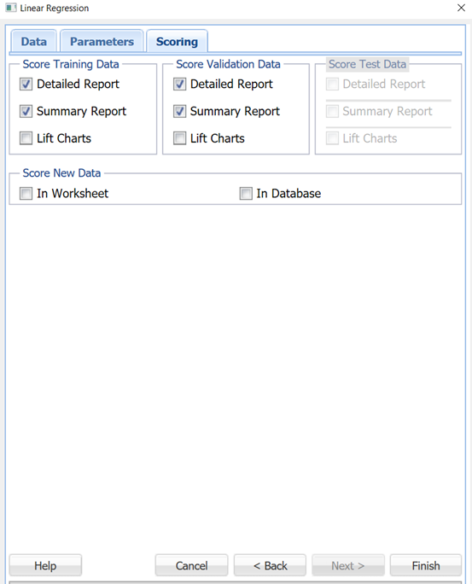
Run the Regression
Once you pick what features selection you want to use to build the model, select next and the scoring page will appear.
For the purpose of this report, I selected multiple reports as seen in the Picture to the right
Last step it to select the finish button and the model and various outputs will be created in a spreadsheet.

Slide 9
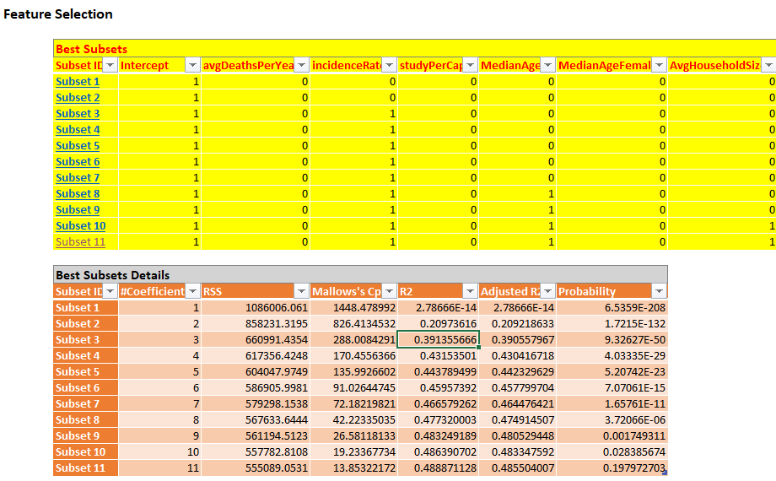
Regression and it output sheets
For the purpose of this report, we are using dimension reduction techniques to help pick significant variable to use in the model.
For this example, I am using the Forward selection model
The last step is to use the linRrg_FS tab to help pick which subsets to use in the final regression model.
I choose to select only 10 subsets by selecting the subset 10 tab.

Slide 10
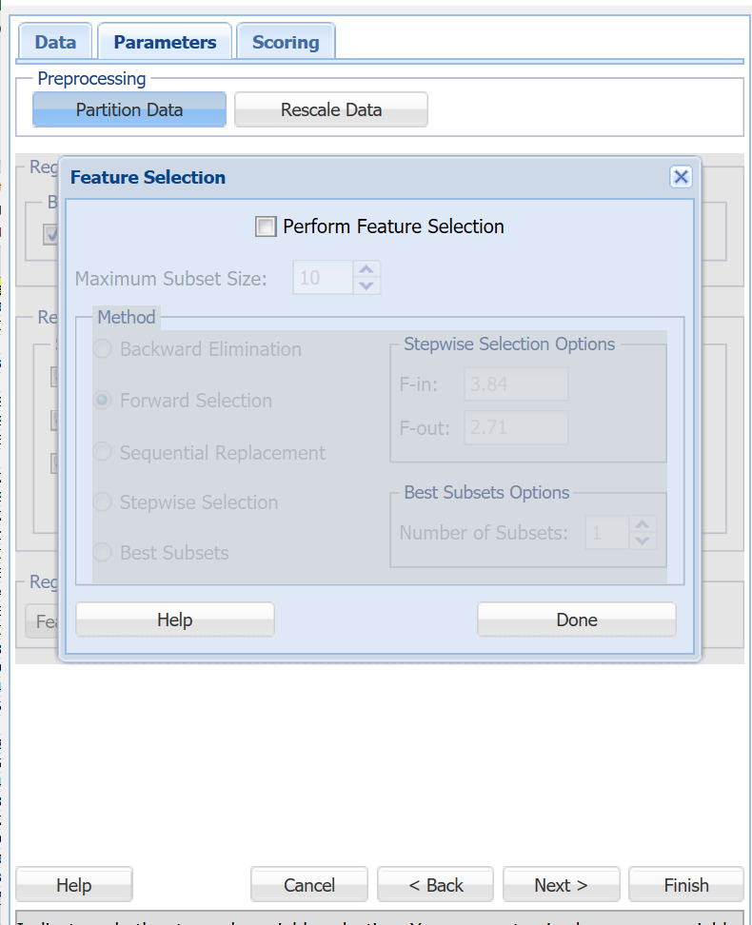
Running the final Regression
Once you have selected the cells with the number of subsets you want to use, a new regression window will open, and it will automatically include the 10 subsets so press next.
The last step is to unselect the Perform Feature selection check box
Once you have chosen what features you want to have in the output
Press finish and you will have you forward selection model generated.

Slide 11
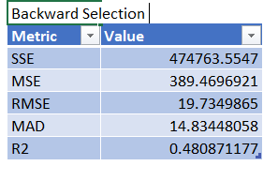
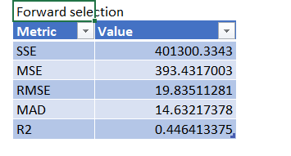
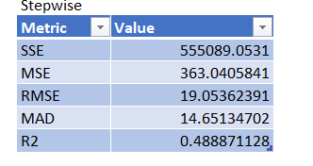
Dimension Reduction Output
Overall if I had to pick what model to use I would use Stepwise dimension reduction because it produce the largest R^2 so explains the most variance.
It also has the lowest MSE which means it has the lowest average error of the models.
Lastly all model have comparable RMSE and MAD so I couldn’t use them to determine which model was best

